Slide 1
GEOG0114: Principles of spatial analysis
WEEK 9: spatial models (part 3)
Dr Anwar Musah (a.musah@ucl.ac.uk)
Lecturer in Social and Geographic Data Science
UCL Geography
1

Slide 2
Contents
Problem
Introduction to Spatial Risk Models for Areal Data
Types of spatial risk estimation
Odds ratios (ORs)
Relative risk ratios (RRs)
Exceedance Probabilities
Spatial intrinsic conditional autoregressive models (ICARs):
Besag-York-Mollie (within an ICAR framework)
Spatial model (with cross-sectional & spatiotemporal data)
Model formulation from a Bayesian Framework
Examples and interpretation
Knowledge
Collect
Model
Wrangle
Explore
2

Slide 3
Recap
Spatial Models
Week 7
Week 8
Week 9
Spatial Lag and Error Models
Geographically Weighted Regression
Spatial Risk
Models
3

Slide 4
What are spatial risk models
4

Slide 5
Definition:
A Spatial Risk Model estimates the probability or intensity of an event (e.g., disease, infestation, flooding, crime) at different geographic locations. These are probabilistic models which are operationalised to quantify how risk varies across space, and time.
The models we have been using previous allows us to quantify relationships globally, or locally, and it was conducted within Frequentist Approach – where we derive an estimate for single values.
Spatial Risk Models are different – they are performed within a Bayesian framework, which relies heavily on probabilistic approach, accounting spatial dependence and heterogeneity, with the main goal to map and understand the geographic variation in risk of an outcome and identify the drivers of that variation in risk!
5

Slide 6
Spatial risk models fall under the family of mainly Poisson & Logistic regression models.
Here is a board overview:
Packages: RStan, INLA, JAGS, WinBUGS
Distribution of dependent variable | Suitable Model
Continuous measures: e.g., average income in postcode (£); concentrations of ambient particular matter (PM2.5); Normalised Vegetative Difference Index (NDVI) etc., | Linear regression
Binary measures (1 = “present” or 0 = “absent”): e.g., Person’s voting for a candidate, Lung cancer risk, house infested with rodents etc., | Logistic Regression
Binomial measure (or proportion): e.g., prevalence of houses in a postcode infested with rodents, percentage of people in a village infected with intestinal parasitic worms, prevalence of household on a street segment victimised by crime etc., | Logistic Regression
Counts or discrete measures: e.g., number of reported burglaries on a street segment, number of riots in a county etc., | Poisson Regression
Time-to-event binary measures: e.g., Lung cancer risk due to chronic exposure to environmental levels of indoor radon. Risk of landslide and time dependence of surface erosion etc., | Survival Analysis with Cox regression
6

Slide 7
Type of spatial risk estimation
7

Slide 8
Areal data
Areal, or lattice data arise when dealing with a fixed domain that is partitioned to a finite number of sub-regions at which the outcome can be aggregated too
Examples of areal data are:
Number of cancer cases in counties
Number of road accidents in districts
Proportion of people living in poverty in postcode block etc.
Often, risk models aim to obtain such estimates geographic areas where data is available. We can use spatial risk models in this context, depending on the type of study design, to estimate the following: Odds Ratios (ORs) or Relative Risk (RRs)
8
Notes:
Bayesian inference with a

Slide 9
Interpretation of Risk Ratios (RR)
RR = 1 (null value), it means that independent variable has no effect on the outcome
RR < 1, the independent variable has an impact on the outcome – in this case, its reduced effect, or reduced risk on the outcome
RR > 1, the independent variable has an impact on the outcome – and so, in this case, its increased effect, or increased risk on the outcome
From hazards models:
Cox Proportional Hazards model
Any Poisson model
9

Slide 10
Interpretation of Odds Ratios (OR)
OR = 1 (null value), it means that independent variable has no effect on the outcome
OR < 1, the independent variable has an impact on the outcome – in this case, its reduced effect, or reduced risk on the outcome
OR > 1, the independent variable has an impact on the outcome – and so, in this case, its increased effect, or increased risk on the outcome
From models:
Binary or Binomial regression model
10

Slide 11
Exceedance Probability
Exceedance Probabilities (or Marginals) is a statistical measure describing the probability that an estimated risk value for an areal-unit exceeds a given threshold.
A common example used in every day application are disease risk models, we are usually concerned about areas that have excess risk of a disease type i.e., P(RR > 1)
In epidemiology, the Exceedance Probabilities have been operationalised a lot to detect clusters of areas with exceedingly high risk of a disease events.
11

Slide 12
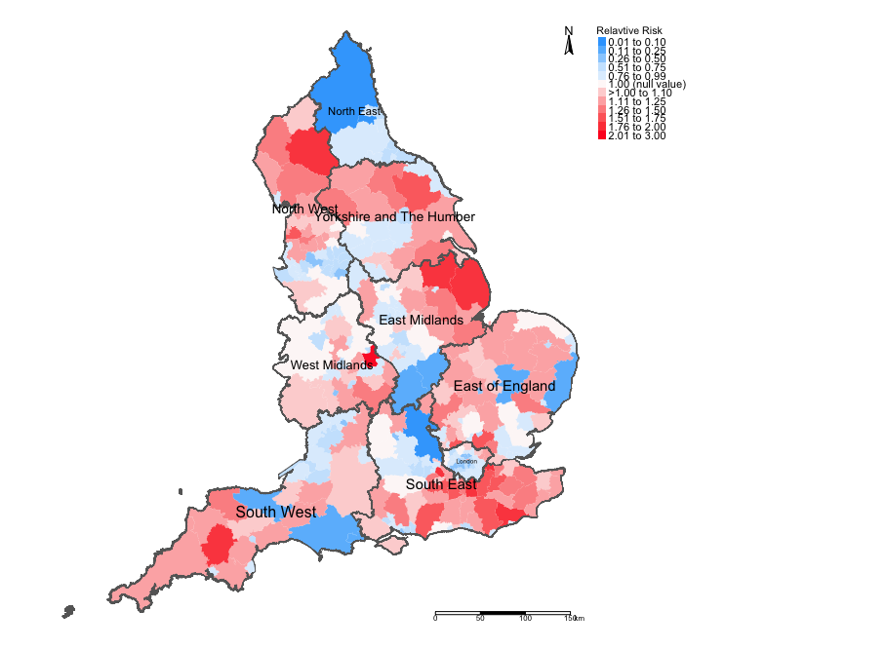
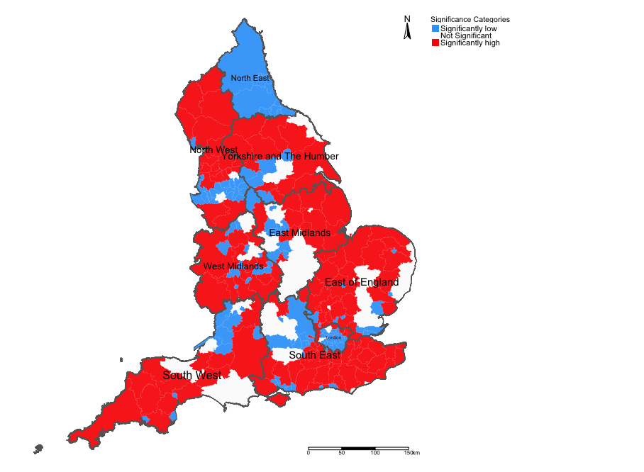
Example: Risks of Road-related casualties in England 2015-2020 [1]
Outcome: Aggregate counts of incident
road accidents at Local Authorities
A: Relative Risk (RR) for each area, summarised on the most plausible value
from its posterior distribution
B: Each area has its own 95% Credibility Intervals. Here, we determine if the null value of 1 does not lie between the lower and upper bounds.
Relative Risks (RR)
Overall significance (95% Credibility Intervals)
12

Slide 13
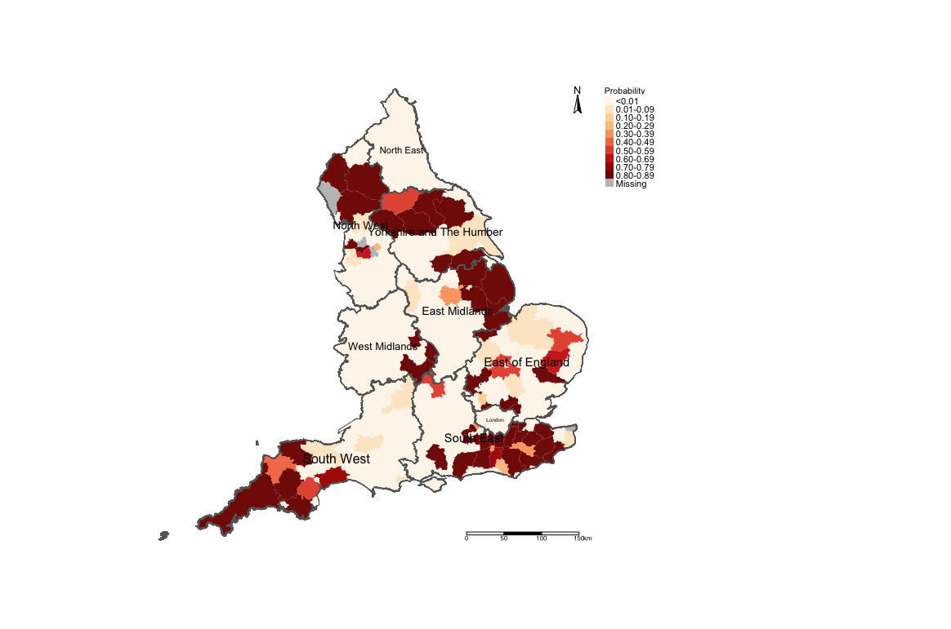
Example: Risks of Road-related casualties in England 2015-2020 [2]
Don’t you think a 40% increased risk of road accidents in an area is too high?
The areas in darker reds are perhaps priority areas for some road safety policy should be implemented.
Here, we have operationalised the concept of exceedance probabilities to compute the probability of an area having a relative risk that is 1.40 or greater than 1.40.
C: Each area has its own probability value to describe the uncertainty surrounding a predicted value.
We use this to ask the question like “… what if an area (despite what we’ve predicted, right…) has a risk that exceeds a certain threshold?
Exceedance Probability i.e., Pr(RR > 1.40) (i.e., risk are 40% higher than expected)
13

Slide 14
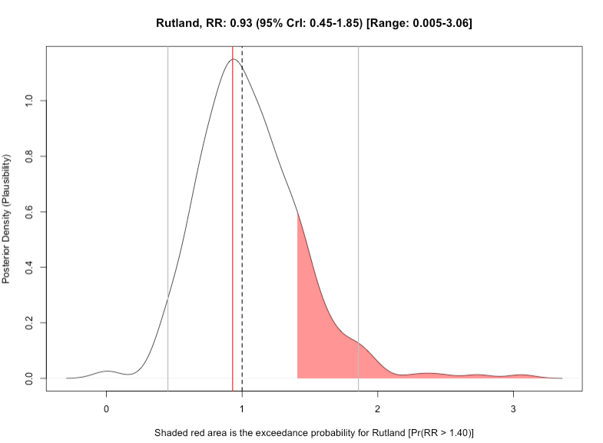
Example: Risks of Road-related casualties in England 2015-2020 [3]
Pr(RR > 1.40) = 0.163
Geographical distribution the exceedance probability for the RR being above 1.40
This graph illustrates the predicted posterior distribution for the relative risk of road accidents in Rutland. The most plausible risk value is 0.93 (95% CrI: 0.45-1.85) [Range: 0.005-3.06]. With exceedance probabilities, we want to know what is the probability that a set of estimates lie above a certain threshold. The exceedance probability for Rutland to have a relative risk of road accidents at/above 1.40 is 16.3%
14

Slide 15
Spatial Conditional Auto-regressive models (CARs/iCARs)
15

Slide 16
Besag-York-Mollie (BYM) (or CAR models)
This is a popular spatial model which takes into account that the data may potentially be spatially correlated and the observations in the neighbouring areas may be more similar than observations in areas that are distant from each other.
This is a type of spatial risk model which includes a spatial random effect,
It is heavily dependent on the neighbourhood adjacency matrix
There are two versions of this model:
BYM model that has ONLY ‘fully specified’ spatial effect – Conditional Auto-Regressive model (CAR)
BYM model that has BOTH a spatial effect term which is treated a structured random effect, and the non-spatial effect term which is treated as an unstructured random effects – Intrinsic Conditional Auto-Regressive Model (ICAR). This is the best option.
When fitting data to this type of model – the best choice of the likelihood function (i.e., statistical model) is Poisson (i.e., aggregated counts to areas).
16
Notes:
Bayesian inference with a

Slide 17
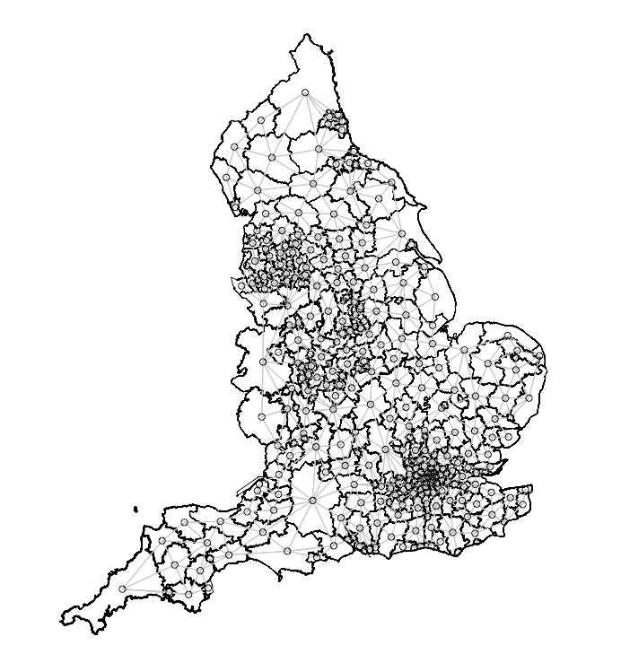
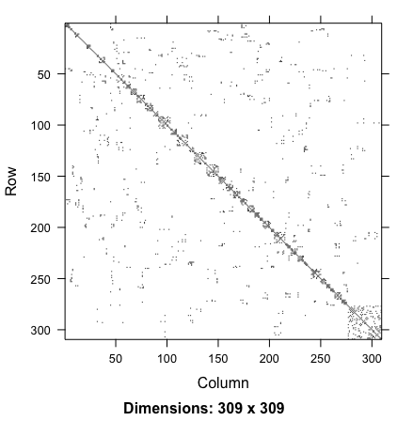
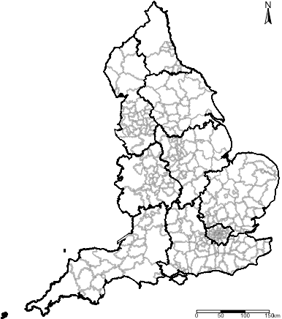
Geographically accurate
neighbourhood structure
Adjacency matrix translated to
graph format
Adjacency matrix translated to
nodes and edge format
INLA uses adjacency matrix (Queen contiguity-based).
Stan only uses the nodes and edges format to reconstruct the adjacency matrix (Queen contiguity-based).
17

Slide 18
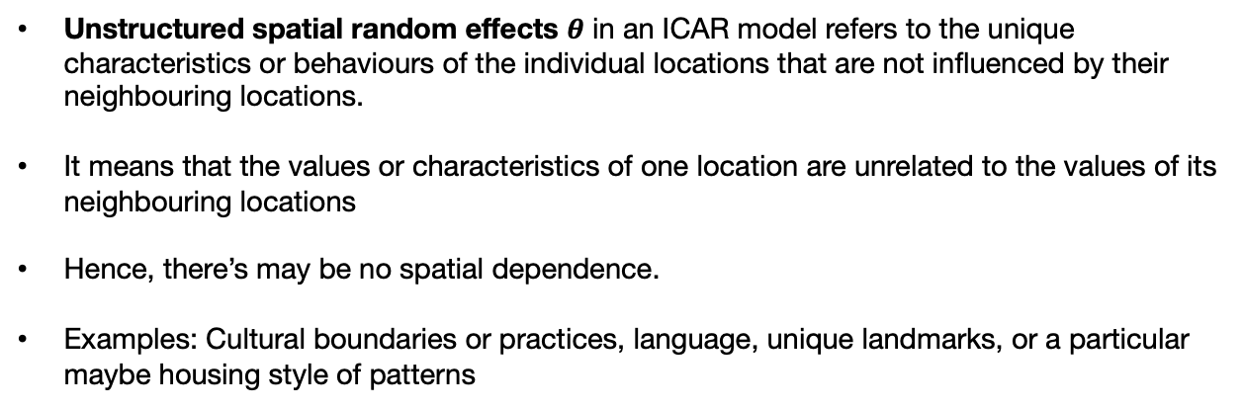
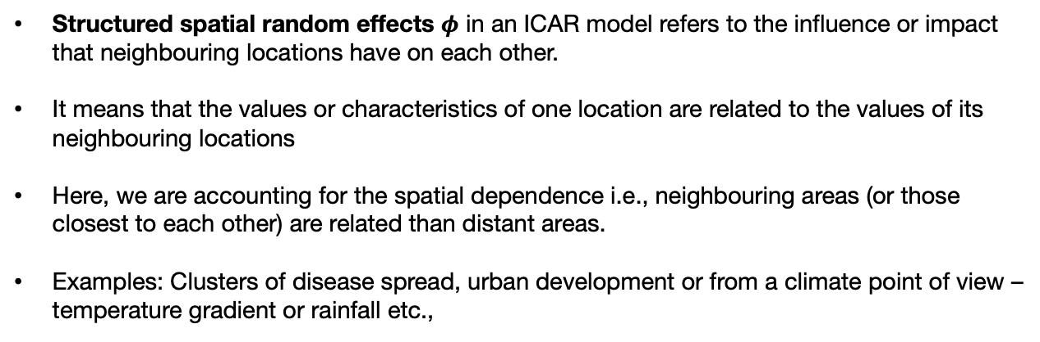
Spatial structured and unstructured random effects [1]
Structured spatial random effects $φ$ in an ICAR model refers to the influence or impact that neighbouring locations have on each other.
It means that the values or characteristics of one location are related to the values of its neighbouring locations
Here, we are accounting for the spatial dependence i.e., neighbouring areas (or those closest to each other) are related than distant areas.
Examples: Clusters of disease spread, urban development or from a climate point of view – temperature gradient or rainfall etc.,
Unstructured spatial random effects $θ$ in an ICAR model refers to the unique characteristics or behaviours of the individual locations that are not influenced by their neighbouring locations.
It means that the values or characteristics of one location are unrelated to the values of its neighbouring locations
Hence, there’s may be no spatial dependence.
Examples: Cultural boundaries or practices, language, unique landmarks, or a particular maybe housing style of patterns
Adjacency matrix translated in graph format
In an ICAR model, we can account for both these types of random effects by COMBINING them as $φ+θ$
18

Slide 19
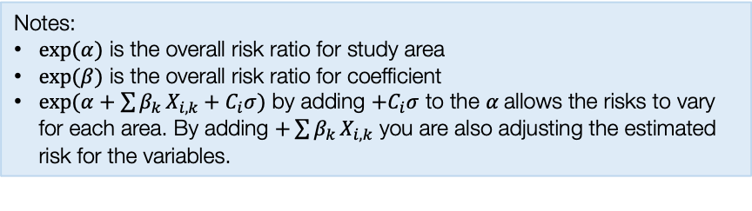
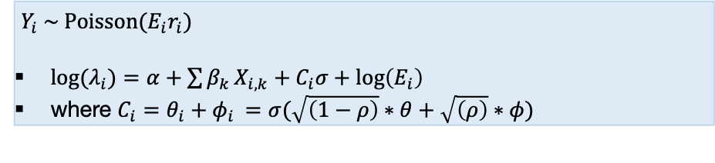
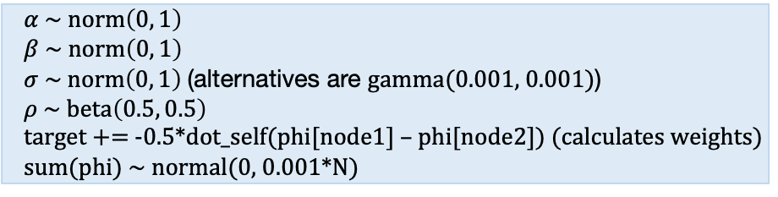
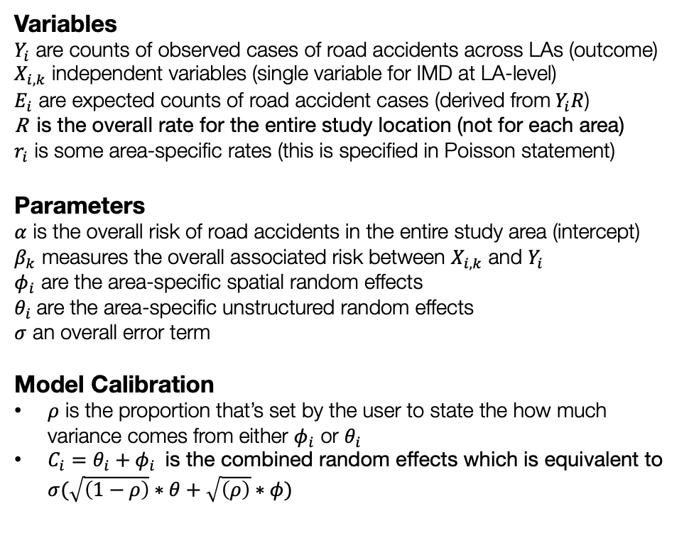
Model formulation for Spatial ICAR model
Model components
Full model specification
Variables
$Y_{i}$ are counts of observed cases of road accidents across LAs (outcome)
$X_{i,k}$ independent variables (single variable for IMD at LA-level)
$E_{i}$ are expected counts of road accident cases (derived from$Y_{i}R$)
R is the overall rate for the entire study location (not for each area)
$r_{i}$ is some area-specific rates (this is specified in Poisson statement)
Parameters
$α$ is the overall risk of road accidents in the entire study area (intercept)
$β_{k}$ measures the overall associated risk between $X_{i,k}$ and $Y_{i}$
$φ_{i}$ are the area-specific spatial random effects
$θ_{i}$ are the area-specific unstructured random effects
$σ$ an overall error term
Model Calibration
$ρ$ is the proportion that’s set by the user to state the how much variance comes from either $φ_{i}$ or $θ_{i}$
$C_{i}=θ_{i}+φ_{i}$ is the combined random effects which is equivalent to $σ(\sqrt{\left(1−ρ\right)}∗θ+\sqrt{\left(ρ\right)}∗φ)$
Specify likelihood function. The outcome often counts – thus it will be Poisson (with log as the link function).
$Y_{i} \sim Poisson(E_{i}r_{i})$
${log⁡(λ}_{i})=α+\sum{β_{k}}X_{i,k}+C_{i}σ+log\left(E_{i}\right)$
where $C_{i}=θ_{i}+φ_{i}$ $=σ(\sqrt{\left(1−ρ\right)}∗θ+\sqrt{\left(ρ\right)}∗φ)$
Define the priors for the intercept, coefficients and spatial and unstructured random effects as with an ICAR specification
$α \sim norm\left(0, 1\right)$
$β \sim norm\left(0, 1\right)$
$σ \sim norm\left(0, 1\right)$ (alternatives are gamma(0.001, 0.001))
$ρ \sim beta\left(0.5, 0.5\right)$
target += -0.5*dot_self(phi[node1] – phi[node2]) (calculates weights)
sum(phi) ~ normal(0, 0.001*N)
Build Bayesian model
Recall the Bayes’ Rule: $P\left(θ | Y\right)∝P\left(Y | θ\right)P(θ)$
Notes:
$exp⁡(α)$ is the overall risk ratio for study area
$exp⁡(β)$ is the overall risk ratio for coefficient
$exp(α+\sum{β_{k}}X_{i,k}+C_{i}σ)$ by adding ${+C}_{i}σ$ to the $α$allows the risks to vary for each area. By adding $+\sum{β_{k}}X_{i,k}$ you are also adjusting the estimated risk for the variables.
$$P\left(α, β_{k}, σ, φ_{i} | { λ}_{i}\right)∝P\left({ λ}_{i} | α, β_{k}, σ, φ_{i}\right) P\left(α\right)P\left(β_{k}\right)P\left(σ\right)P(φ_{i})P\left(ρ\right)$$
Do not worry about this slide – its to show what’s underneath the bonnet of vehicle!!!
19

Slide 20
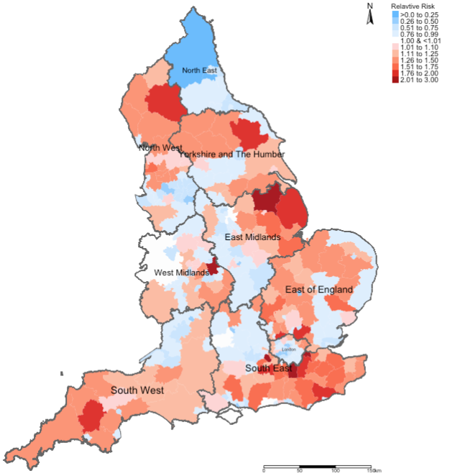
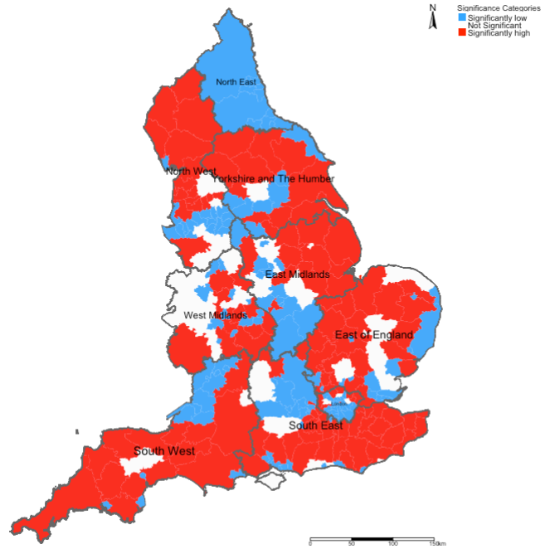
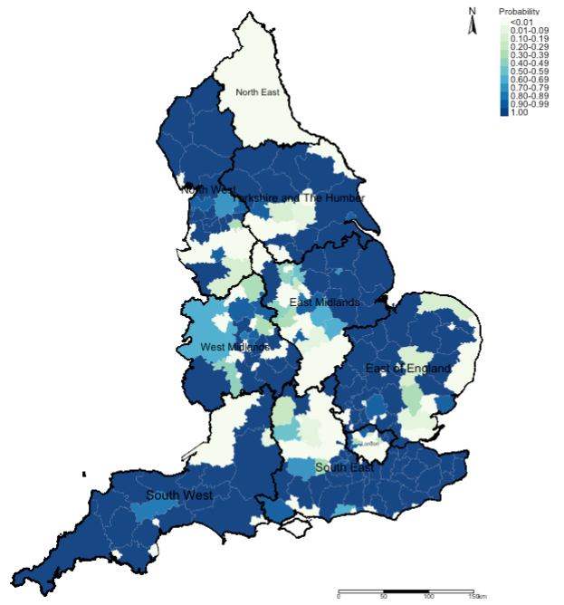
Expected output [1]
Relative risk ratios (RR)
Statistical Significance
Exceedance Probabilities
Here, we use this output to describe the burden of an outcome
This output is to valid whatever hypothesis we had about the described outcome’s burden in the first map
This output is used to describe the uncertainty that surrounds the risks we found in the first map when we explore P(RR>1.00)
20

Slide 21
Expected output [2]
Relative risk ratios (RR)
Statistical Significance
Exceedance Probabilities
Interpretation: We can see that the risk patterns for road accidents across England are quite heterogeneous. While it is quite pronounced in all 10 regions in England, the burden is quite significant in Southwest region with large numbers of local authorities having an increased risk which are statistically significant. Perhaps, the Department for Transport should do an investigation on these patterns starting with the Southwest area.
21

Slide 22
Application 1: Risk assessment and mapping of infestation in Campina Grande (cross-sectional)
22

Slide 23
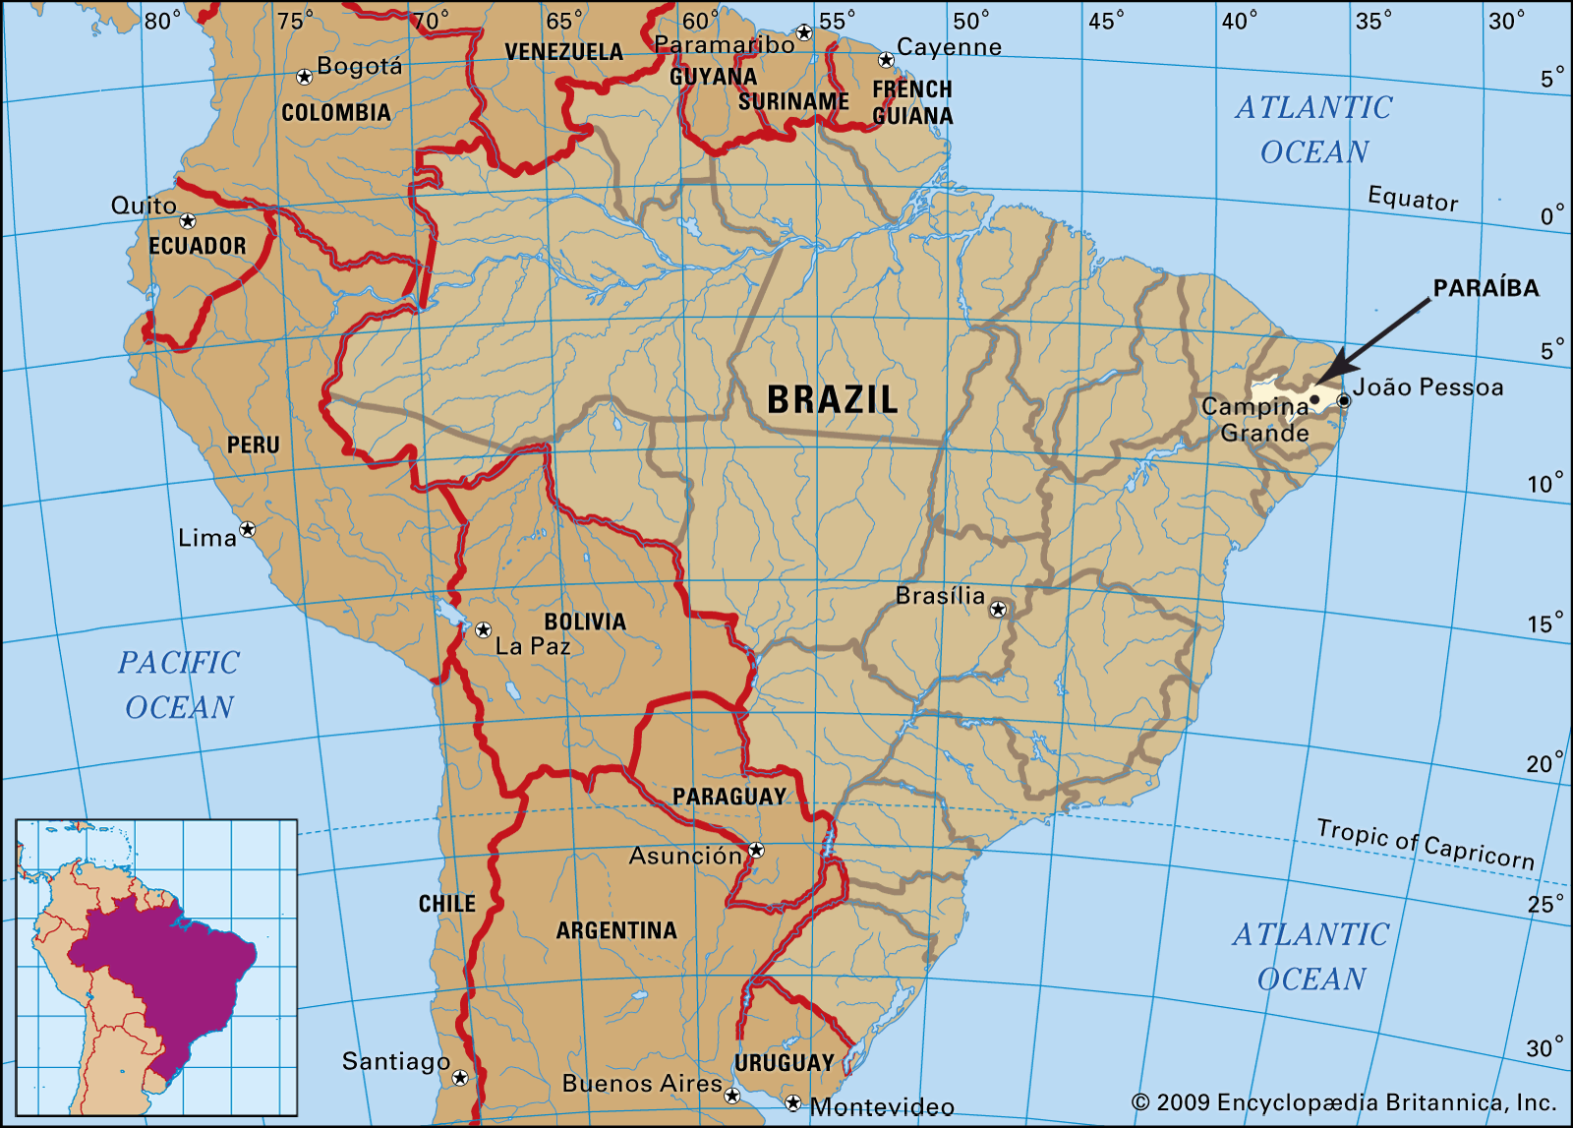
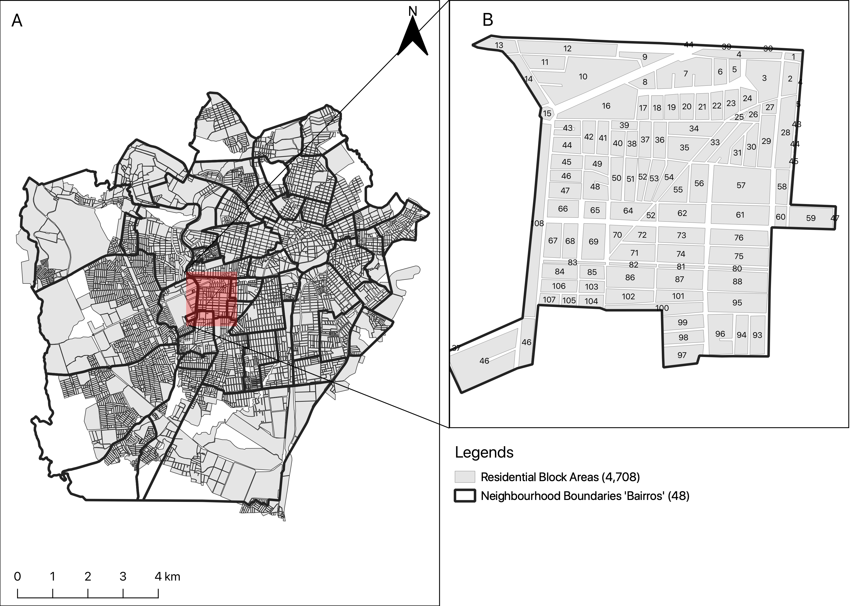
Campina Grande is into 47 neighbourhoods
Most recent vector control data (Levantamento Rapid de Indice para Aedes a [LIRAa]): January 2013 to October 2017 (performed 3–5 times in a year)
Baseline information – the overall number of houses in neighbourhood (as denominators); total number of households detected to be infested with larvae or adult mosquito (i.e., Aedes aegypti)
Aims and objectives:
To quantify the risk trajectories of mosquito infestation on a neighbourhood-level to informs the profile of the neighbourhood (i.e., whether the risks were ‘high’ or ‘low’ in that observed LIRAa period i.e., April 2017).
Determining the set of environmental, climate and anthropogenic risk factors that impact neighbourhood-levels of Aedes aegypti infestation in households.
23
Notes:
Portuguese: Levantamento Rapido de Indice para Aedes aegypti (Rapid Index Survey for Aedes aegypti)
The goal is to harness this rich resource in order to…

Slide 24
Research Methodology & Study design
 | Survey Periods
LIRAa | 2013 | 2014 | 2015 | 2016 | 2017
1 | January | January | January | April | January
2 | March | March | March | July | April
3 | May | May | May | October | July
4 | July | July | October
5 | October | October
Using this snapshot time-period for April to demonstrate the application
Methodology:
Population-based ecological study design within cross-sectional (and retrospective) framework
For covariates, the analysis included:
WorldClim (4.5km) (Maximum temperature and Precipitation) (monthly)
MOD18A1.061 Terra Vegetation Indices 16-Day Global 500m to compute neighbourhood levels of vegetation based on the NDVI metrics (monthly)
Worldpop.org (100m) to extract rasters for urbanisation (which contains binary grids) to compute the fraction of surface that is urbanised for neighbourhoods (yearly).
Spatial risk model with Intrinsic Conditional Autoregressive (ICAR) Model; and to derive new global coefficients for covariates for at that survey period for April 2017, as well as neighbourhood-specific relative risk estimates.
24
Notes:
In terms of methodology, we utilised

Slide 25
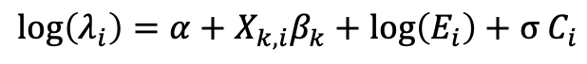
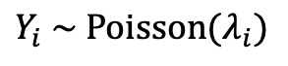
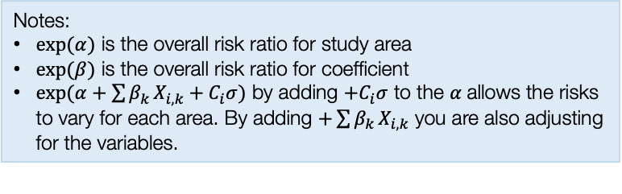
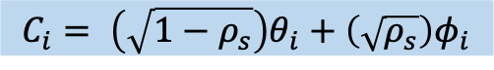
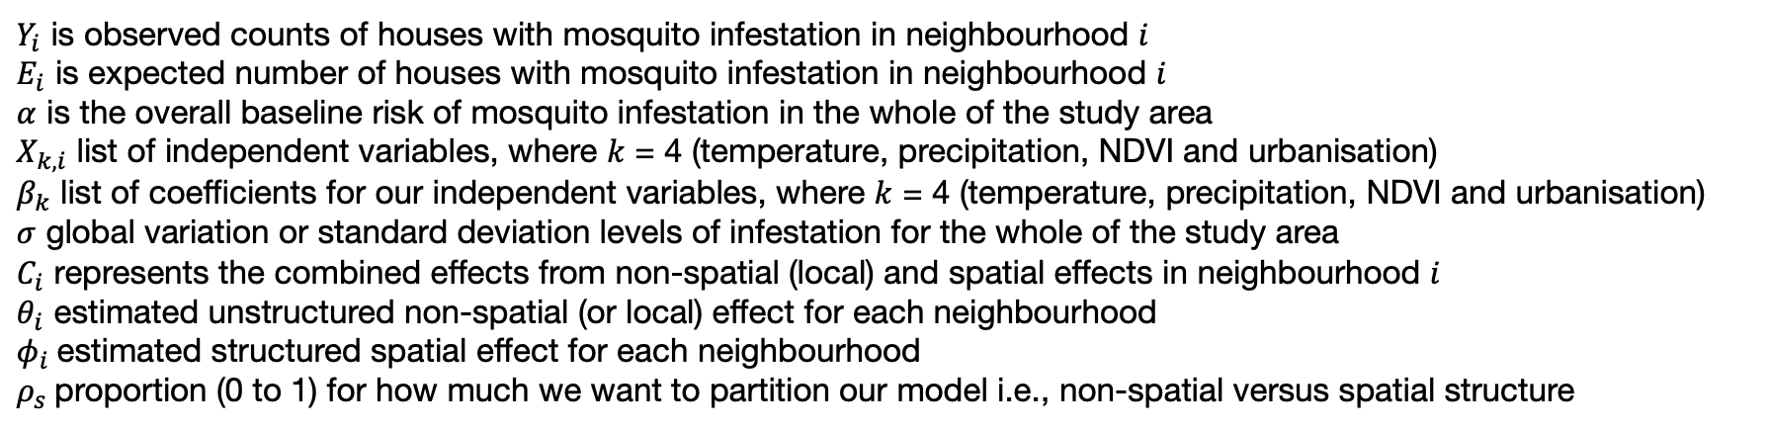
Cross-sectional (single time-point scenario)
$$Y_{i} \sim Poisson(λ_{i})$$
Notes:
$exp⁡(α)$ is the overall risk ratio for study area
$exp⁡(β)$ is the overall risk ratio for coefficient
$exp(α+\sum{β_{k}}X_{i,k}+C_{i}σ)$ by adding ${+C}_{i}σ$ to the $α$allows the risks to vary for each area. By adding $+\sum{β_{k}}X_{i,k}$ you are also adjusting for the variables.
$$\log\left(λ_{i}\right)=α+X_{k,i}β_{k}+\log\left(E_{i}\right)+σ C_{i}$$
$$C_{i}= \left(\sqrt{1−ρ_{s}}\right)θ_{i}+\left(\sqrt{ρ_{s}}\right)φ_{i}$$
combined =
+
spatial
non-spatial
$Y_{i}$ is observed counts of houses with mosquito infestation in neighbourhood $i$
$E_{i}$ is expected number of houses with mosquito infestation in neighbourhood $i$
$α$ is the overall baseline risk of mosquito infestation in the whole of the study area
$X_{k,i}$ list of independent variables, where $k$ = 4 (temperature, precipitation, NDVI and urbanisation)
$β_{k}$ list of coefficients for our independent variables, where $k$ = 4 (temperature, precipitation, NDVI and urbanisation)
$σ$ global variation or standard deviation levels of infestation for the whole of the study area
$C_{i}$ represents the combined effects from non-spatial (local) and spatial effects in neighbourhood $i$
$θ_{i}$ estimated unstructured non-spatial (or local) effect for each neighbourhood
$φ_{i}$estimated structured spatial effect for each neighbourhood
$ρ_{s}$proportion (0 to 1) for how much we want to partition our model i.e., non-spatial versus spatial structure
25

Slide 26
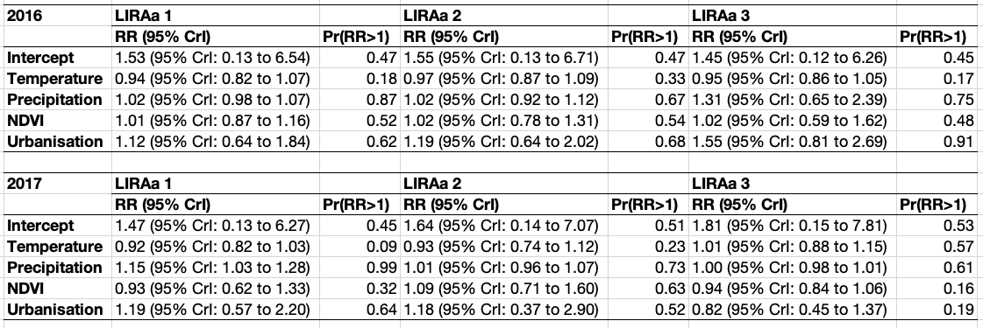
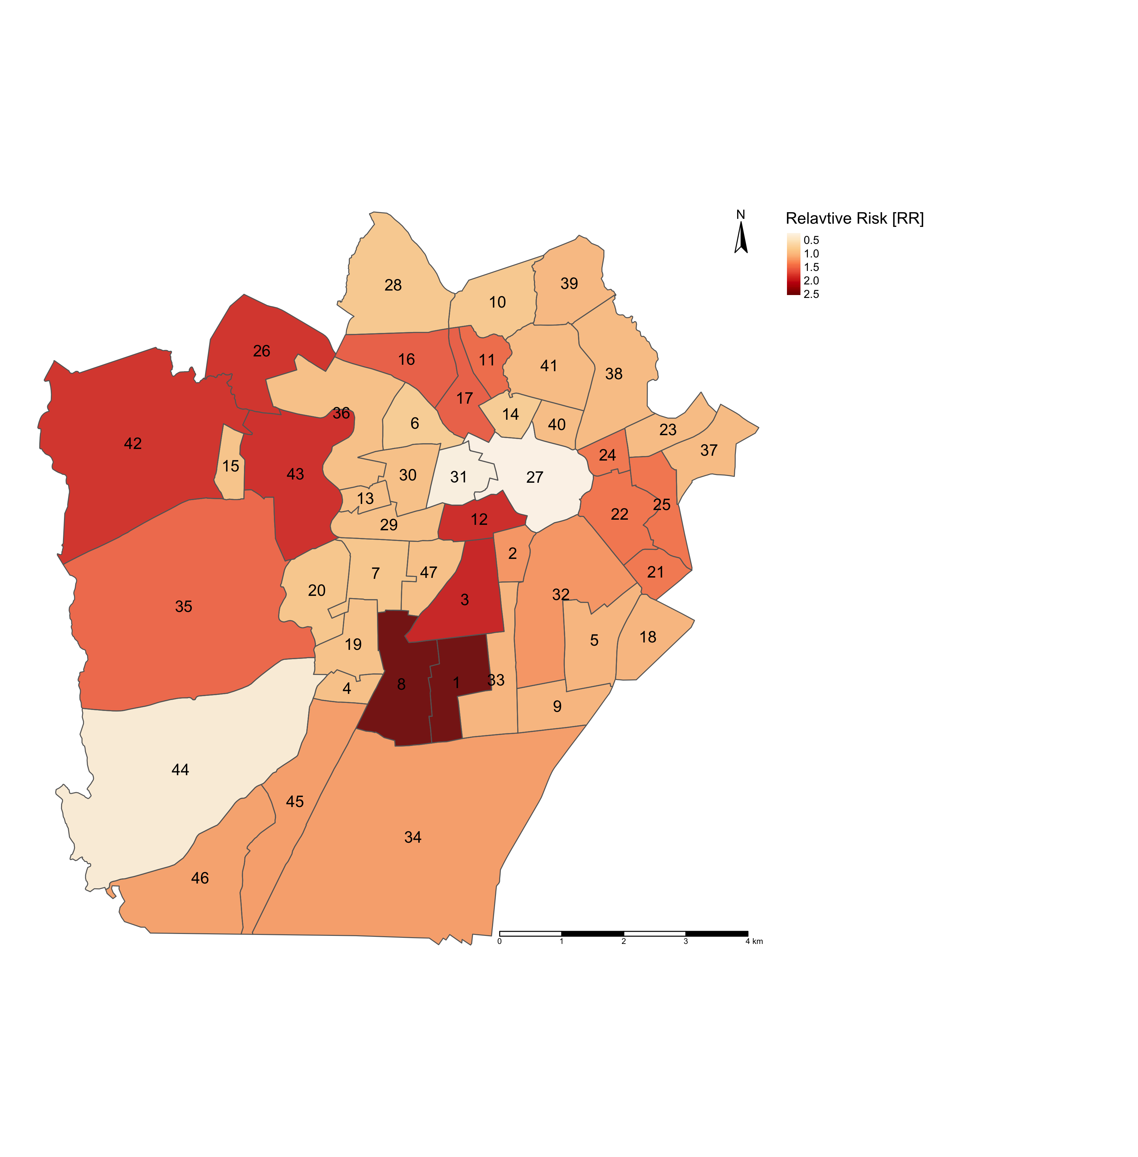
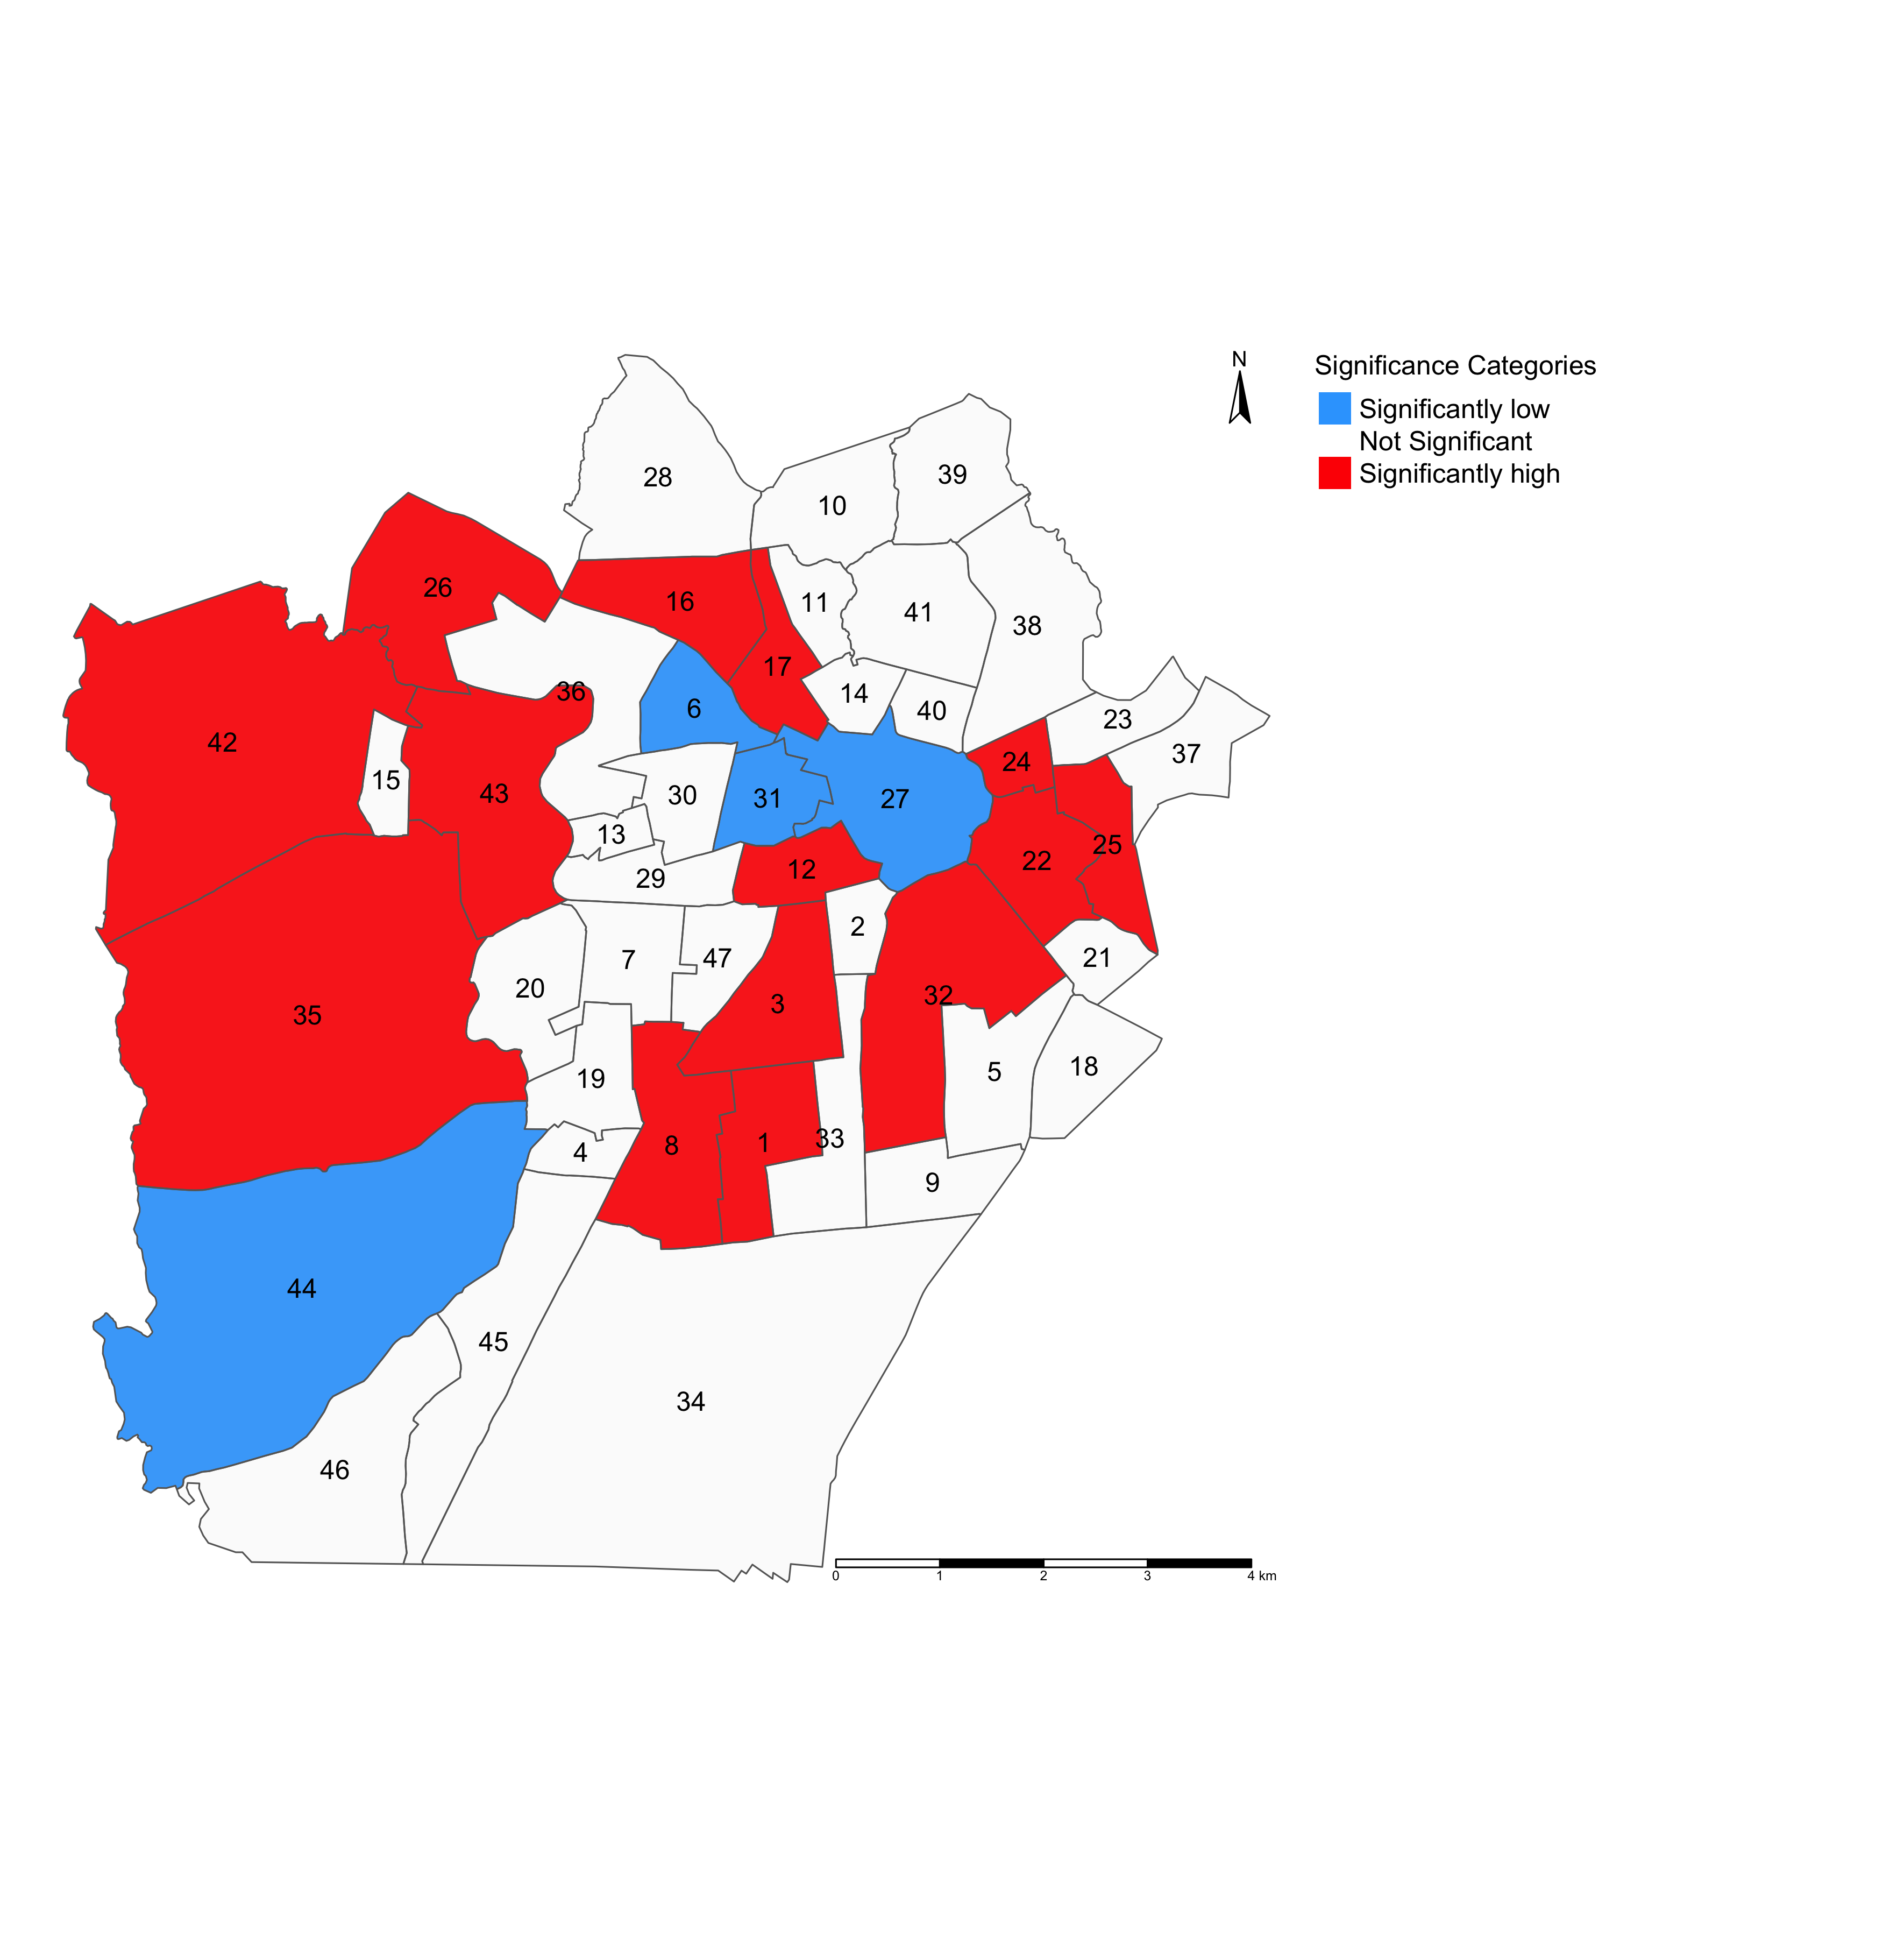
PART 1: Table results that illustrates the GLOBAL association between environmental, climate and anthropogenic factors and risk of infestation in Campina Grande (in LIRAa 2 survey period for April 2017).
Interpretation (examples):
Intercept: The overall baseline risk of mosquito-borne infestation is 1.64 times (or 64%) greater in the population of Campina Grande. The overall probability that there’s excess risk of infestation (i.e., RR > 1.00) is 51%.
Temperature: In relation to temperature, the risk of mosquito-borne infestation is 0.93 times (or 7%) lower in Campina Grande. The probability of observing an excess risk of infestation (i.e., RR > 1.00) in relation to temperature is 23%.
Urbanisation index: In relation to urbanisation, the risk of mosquito-borne infestation is 1.18 times (or 18%) higher in Campina Grande. The probability of observing an excess risk of infestation (i.e., RR > 1.00) in relation to urbanisation is 52%.
NOTE: All relative risk estimates have the null value (1) between its lower and upper 95% credibility intervals. While the results, excluding temperature, show an increased risk of infestation – these are all statistically not significant.
RR: Relative risks; Pr(RR > 1): Exceedance probabilities (the probability that RR being greater than 1)
PART 2: Maps on the left panel illustrates the relative risk (RR) of infestation across neighbourhoods in Campina Grande
PART 3: Maps on the right panel illustrates which neighbourhoods in Campina Grande have RRs that are significantly “low” or “high” risk
LIRAa 2 2017
LIRAa 2 2017
Interpretation:
The following neighbourhoods in Campina Grande numbered 1, 3, 8 and 12 (for example) have RRs that are significantly above 1.00. These are examples of neighbourhoods containing households predicted to be at ‘high risk’ of being infested with mosquitoes. Neighbourhoods painted in RED need to be monitored for mosquito breeding hotspots to prevent further infestation, which, in turn, can lead to infectious disease outbreaks e.g., Zika or Dengue viruses!
RR < 1.00 (Low risk)
RR > 1.00 (High risk)
RR = 1.00 (Non-significant risk)
Continuous RR estimates
RR estimates categorised:
26

Slide 27
Application 2: Risk assessment fire-related casualties in England 2010-19 (Spatiotemporal)
27

Slide 28
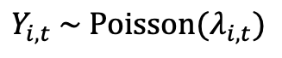
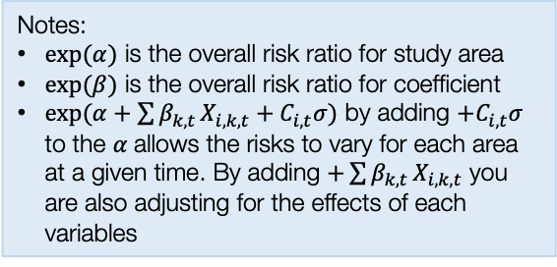
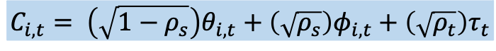
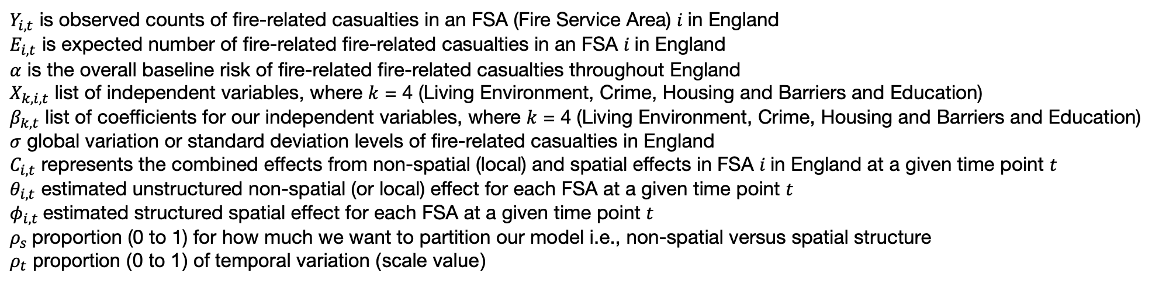
Longitudinal (spatiotemporal scenario)
$$Y_{i,t} \sim Poisson(λ_{i,t})$$
Notes:
$exp⁡(α)$ is the overall risk ratio for study area
$exp⁡(β)$ is the overall risk ratio for coefficient
$exp(α+\sum{β_{k,t}}X_{i,k,t}+C_{i,t}σ)$ by adding ${+C}_{i,t}σ$ to the $α$allows the risks to vary for each area at a given time. By adding $+\sum{β_{k,t}}X_{i,k,t}$ you are also adjusting for the effects of each variables
$$\log\left(λ_{i,t}\right)=α+X_{k,i,t}β_{k,t}+\log\left(E_{i,t}\right)+σ C_{i,t}$$
$$C_{i,t}= \left(\sqrt{1−ρ_{s}}\right)θ_{i,t}+\left(\sqrt{ρ_{s}}\right)φ_{i,t}+\left(\sqrt{ρ_{t}}\right)τ_{t}$$
combined =
+
spatial
+
temporal
non-spatial
$Y_{i,t}$ is observed counts of fire-related casualties in an FSA (Fire Service Area) $i$in England
$E_{i,t}$ is expected number of fire-related fire-related casualties in an FSA $i$in England
$α$ is the overall baseline risk of fire-related fire-related casualties throughout England
$X_{k,i,t}$ list of independent variables, where $k$ = 4 (Living Environment, Crime, Housing and Barriers and Education)
$β_{k,t}$ list of coefficients for our independent variables, where $k$ = 4 (Living Environment, Crime, Housing and Barriers and Education)
$σ$ global variation or standard deviation levels of fire-related casualties in England
$C_{i,t}$ represents the combined effects from non-spatial (local) and spatial effects in FSA $i$in England at a given time point $t$
$θ_{i,t}$ estimated unstructured non-spatial (or local) effect for each FSA at a given time point $t$
$φ_{i,t}$estimated structured spatial effect for each FSA at a given time point $t$
$ρ_{s}$proportion (0 to 1) for how much we want to partition our model i.e., non-spatial versus spatial structure
$ρ_{t}$ proportion (0 to 1) of temporal variation (scale value)
28

Slide 29
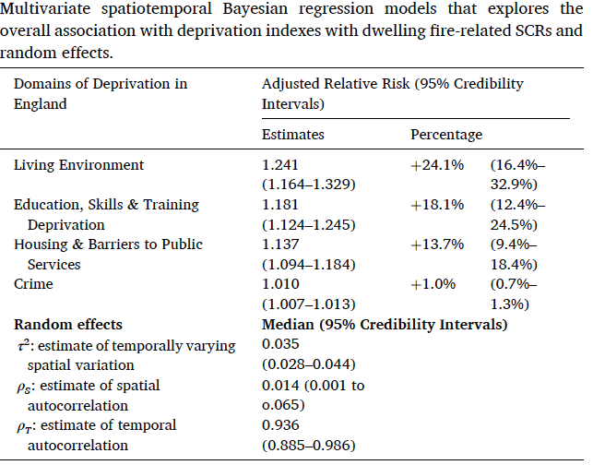
Table results illustrates the overall association between socioeconomic deprivation factors and risk of fire-related casualties in England (2010-19).
Interpretation:
Living environment: In the context of this socioeconomic deprivation domain – increased levels significantly increases the risk of fire-related casualties by 24.1% (1.241 times higher).
Barriers to housing and public service: In the context of this socioeconomic deprivation domain – increased levels significantly increases the risk of fire-related casualties by 13.7% (1.137 times higher).
Education, Skills & Training: In the context of this socioeconomic deprivation domain – increased levels significantly increases the risk of fire-related casualties by 18.1% (1.181 times higher).
Crime: In the context of this socioeconomic deprivation domain – increased levels marginally increases the risk of fire-related casualties by 1.0% (1.01 times higher). While this is statistically significant, the significance can be seen as something that is marginal.
NOTE: The random effects are reported in this instance to show the variation in risk. Most of it is captured in the time component (0.936 = 93.6%) meaning that there is a very strong temporal autocorrelation in the data.
Source: Li et al, (2022), Ecological study exploring the geospatial
associations between socioeconomic deprivation and
fire-related dwelling casualties in England (2010-2019),
DOI: https://doi.org/10.1016/j.apgeog.2022.102718
29

Slide 30
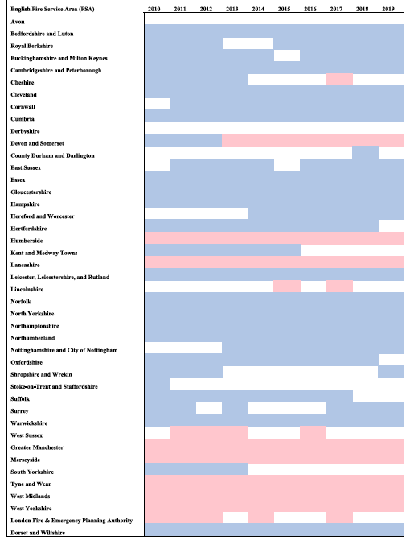
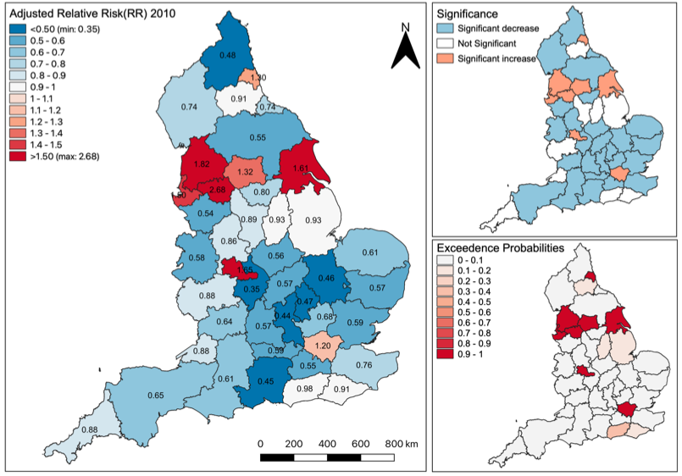
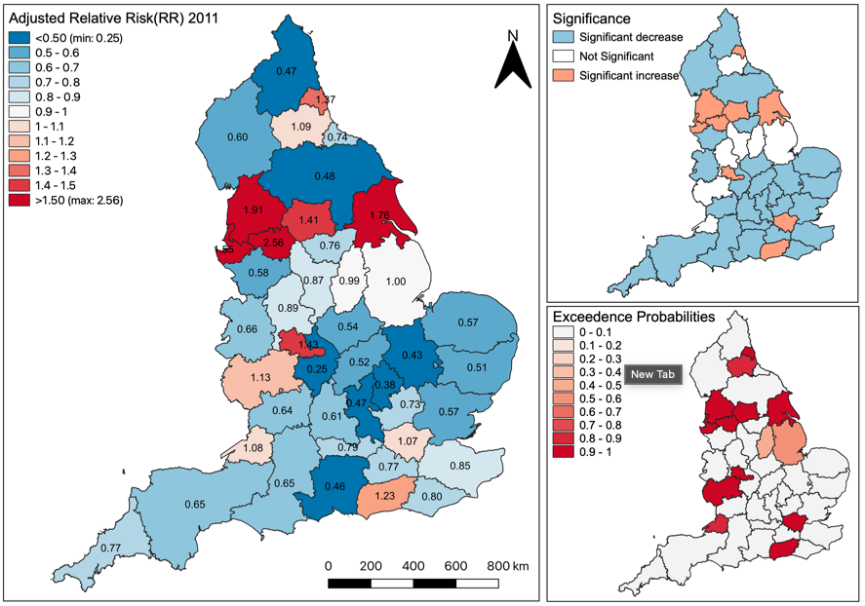
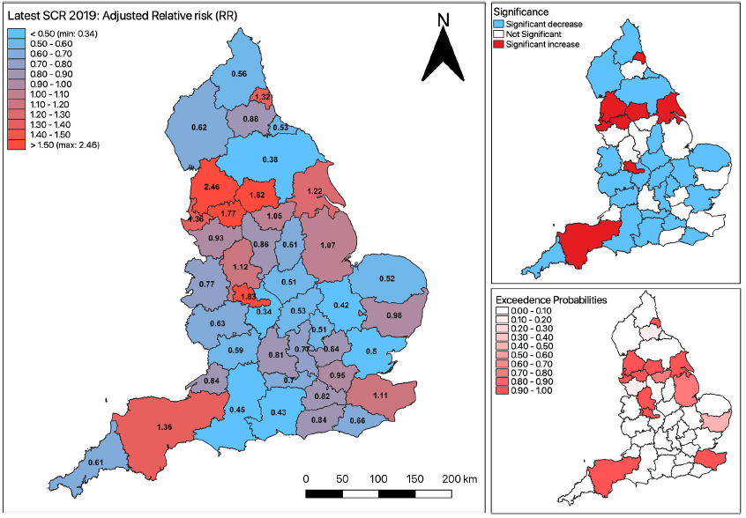



Spatial and temporal variation in risk of fire-related casualties
Translate maps to show significant risk trajectories
$$⋱$$
$$⋱$$
>>>
$$⋱$$
Interpretation: On a year-on-year basis, the increased risks are significantly sustained throughout the 10-year period for Humberside, Lancaster, Greater Manchester, Merseyside, Tyne and Wear, West Midlands, West Yorkshire, and Devon & Somerset.
Source: Li et al, (2022), Ecological study exploring the geospatial associations between socioeconomic deprivation and fire-related dwelling casualties in England (2010-2019). DOI: https://doi.org/10.1016/j.apgeog.2022.102718
30

Slide 31
Any questions?
31

